Slide 1
Debrief 13/04/23

Slide 2



Week 5: Corporate Project & Start of Mentorship
 | Monday 10 April | Tuesday 11 April | Wednesday 12 April | Thursday 13 April | Friday 14 April
10.00am to 12.30pm | Corporate Project Meeting Project Sponsors 2 | Corporate Project | Job Readiness Workshop Mentorship Session 1 | Job Readiness Communications Workshop | Digital Skills Learning
12.30pm to 2pm | Lunch Break | Lunch Break | Lunch Break | Lunch Break | Lunch Break
2pm to 4.30pm | Corporate Project | Corporate Project | Job Readiness Workshop Corporate Profile Shot | Job Readiness Communications Workshop | Digital Skills Learning
In-person session at
Republic Polytechnic
Work From Home (WFH)
Flexible arrangement
Company Visit

Slide 3
Week 6: Prep for Mid-term Review
 | Monday 17 April | Tuesday 18 April | Wednesday 19 April | Thursday 20 April | Friday 21 April
10.00am to12.30pm | Corporate Project Meeting Project Sponsors 3 | Corporate Project | Job Readiness Workshop Micron Visit | Personal Growth TomoWork’s Got Talent | Digital Skills Learning
12.30pm to 2pm | Lunch Break | Lunch Break | Lunch Break | Lunch Break | Lunch Break
2pm to 4.30pm | Corporate Project | Corporate Project | Job Readiness Linkedin Clinic & Visit | Personal Growth TomoWork’s Got Talent | Digital Skills Learning
In-person session at
Republic Polytechnic
Work From Home (WFH)
Flexible arrangement
Company Visit

Slide 4
Programme for 17th April 2023 (Monday)
Time | Event | Venue
9.50am | Report to Republic Poly
10am -12.30pm | Corporate Project – Prep for mid-term review | E1 6T – Kinjo rubber LIBN1 – MSD LIBN2 – foodpanda LIBN3 – EVCO LIBN4 - Micron
12.30pm – 2pm | Lunch
2pm - 4pm | Corporate Project – Prep for mid-term review
4.15pm – 4.30pm | Debrief
4.30pm | Dismissal
Things to Bring: Laptop with Charger, money for lunch, comb, writing materials and handphone.
Wear: Smart Casual

Slide 5
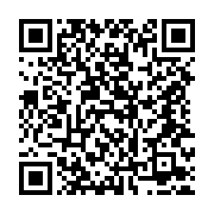
Week 5 Survey *new* (Complete by today)
https://tomowork.typeform.com/to/p9kuqweX

Slide 6
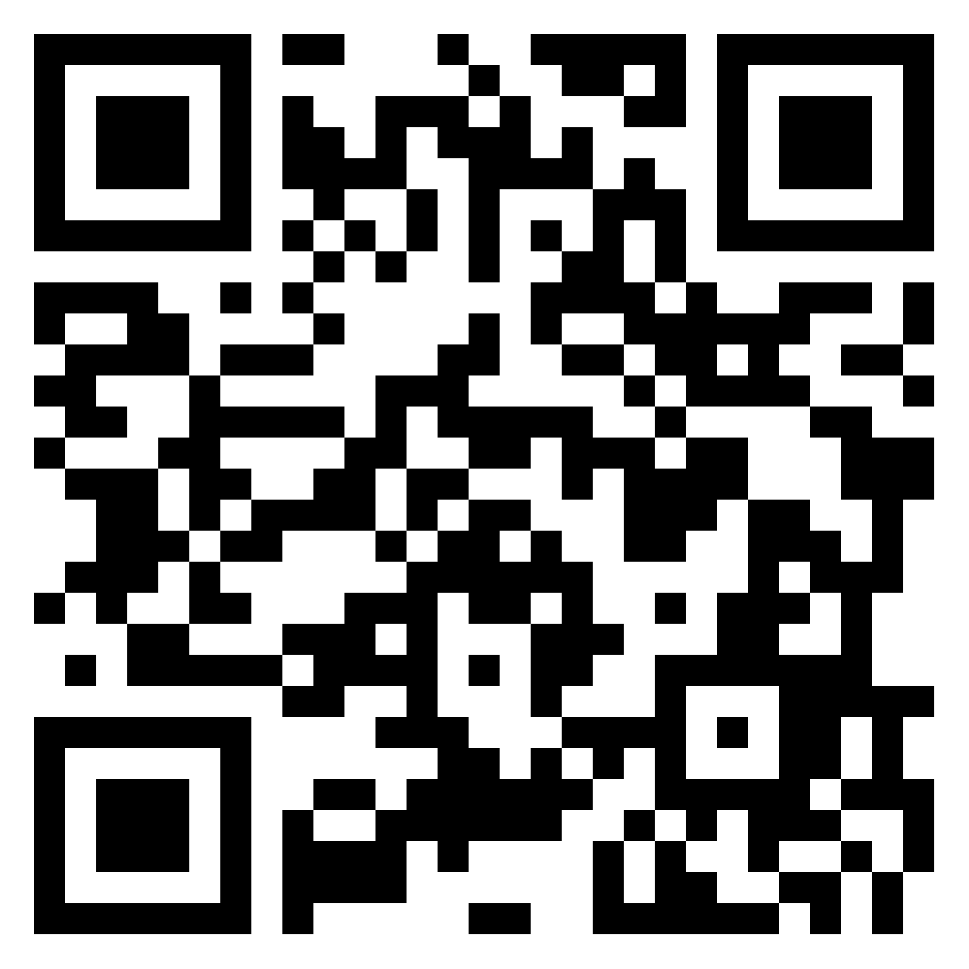
Week 5 Reflection (Complete by today)

